Slide 1
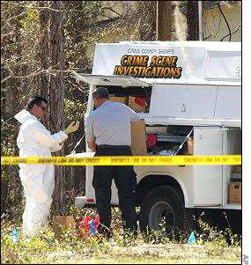
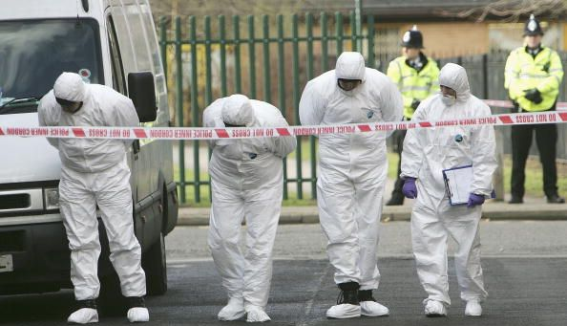
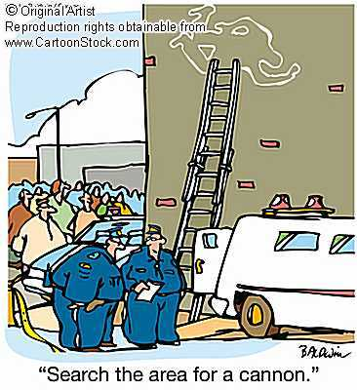
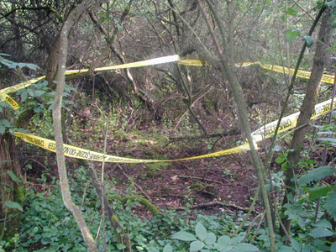
Crime Scene Searches

Slide 2
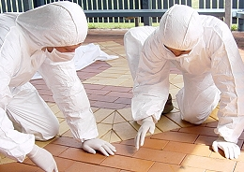

Crime Scene Search
Crime Scenes are 3-dimensional
-floors, walls,
ceilings
Careful and methodical search

Slide 3
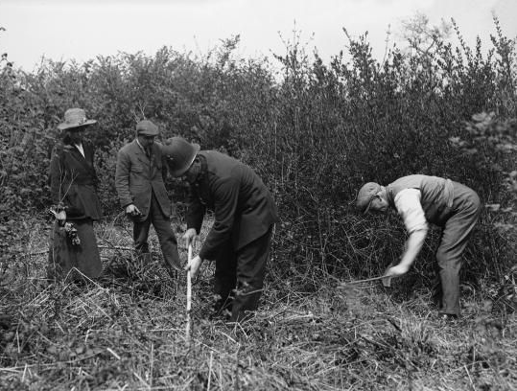

Do not dismiss anything until its evidentiary value can be determined
Avoid disturbing or destroying any evidence

Slide 4
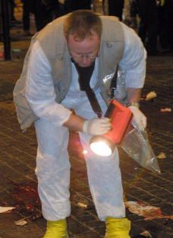
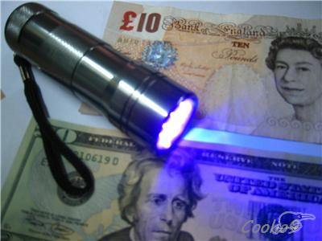
If a crime scene investigator shines a flashlight on the ground at various angles, even when there's plenty of lighting, he'll create new shadows that could reveal evidence.

Slide 5
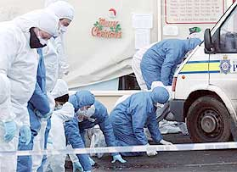
Because every crime scene is different, every crime scene requires an individual approach. For example, a murder that occurred outdoors requires a search confined to a specific, relatively smaller area, whereas a bomb explosion can scatter evidence over a very large distance. However, there are certain general rules that guide the search plans for searching a crime scene.

Slide 6
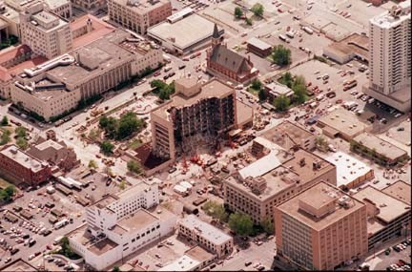

Slide 7
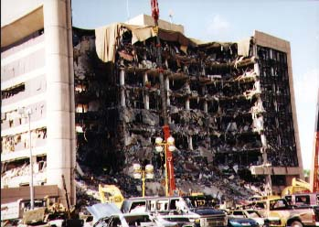

Slide 8
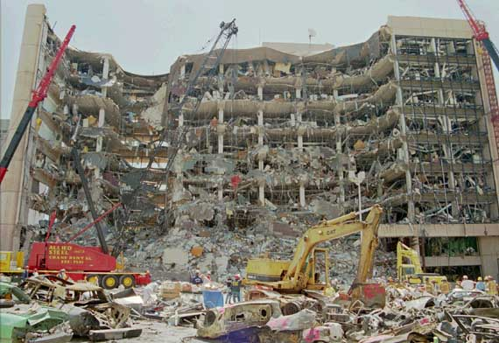

Slide 9
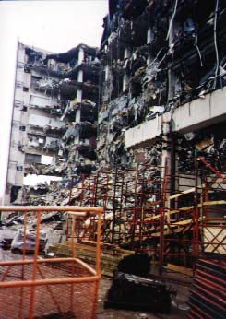

Slide 10
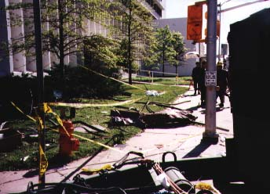

Slide 11
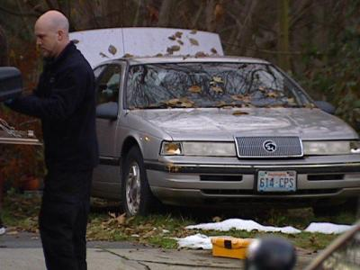

Slide 12


Think about this question:
Are there things you throw away that you and your family would not like everyone to see?
How about . . .
Receipts
Love letters
Letters sent home from teachers
Computer disks
Underwear
Photos
Notes:
On slide: Are there things you throw…
Click 1: How about…
Click 2: Love letters + graphic.
Click 3: Receipts + graphic.
Click 4: Notes home… + graphic.
Click 5: Computer disks + graphic.
Click 6: Underwear + graphic.
Click 7: Photos + graphic.
1. Ask: What else might people throw away that they wouldn’t want others to see?
2. Explain: The case of California v. Greenwood was about trash and the issue of privacy.
Click to next slide.

Slide 13
There is a very important case that went to the U.S. Supreme Court concerning searches. The name of the case is California v. Greenwood.
Here are the facts:
In 1984, Billy Greenwood was arrested in California on felony narcotics charges. He was tried in Superior Court and convicted.
Guilty!
The police had collected most of the evidence against Greenwood from dark green plastic trash bags (the kind you can’t see through).
Notes:
On slide: You are going to…
Click 1: Here are the facts + In 1984… + graphic.
Click 2: The police had… + graphic.
Click to next slide.

Slide 14
Greenwood had left the bags out for the trash collector. They sat on the curb in front of his house.
The police did not have a search warrant. But, they did get permission from the trash collector to look through Greenwood’s trash bags.
Notes:
On slide: Blue background.
Click 1: Greenwood had left… + truck drives in
Click 2: The police did not…
Click to next slide.

Slide 15
Under the Fourth Amendment, to conduct a search, police need...
“probable cause,” or a reason to suspect, that a person has committed a crime,
“consent,” or permission, from the person or property owner,
or a search warrant.
The police had
none of these.
Notes:
On slide: Under the Fourth Amendment…
Click 1: “probable cause,”…
Click 2: “consent,”…
Click 3: or a search warrant.
Click 4: The police had....
1. Ask:
What was Billy Greenwood convicted of?
Where did the police find most of the evidence?
Where were the trash bags located?
What do the police need to conduct a legal search?
What do you suppose happened next?
Click to next slide.

Slide 16
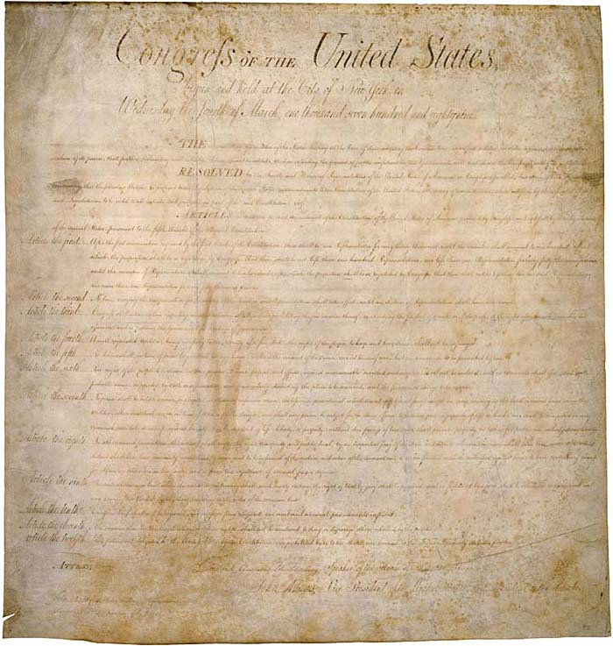
Where do the search & seizure rules come from?

Slide 17
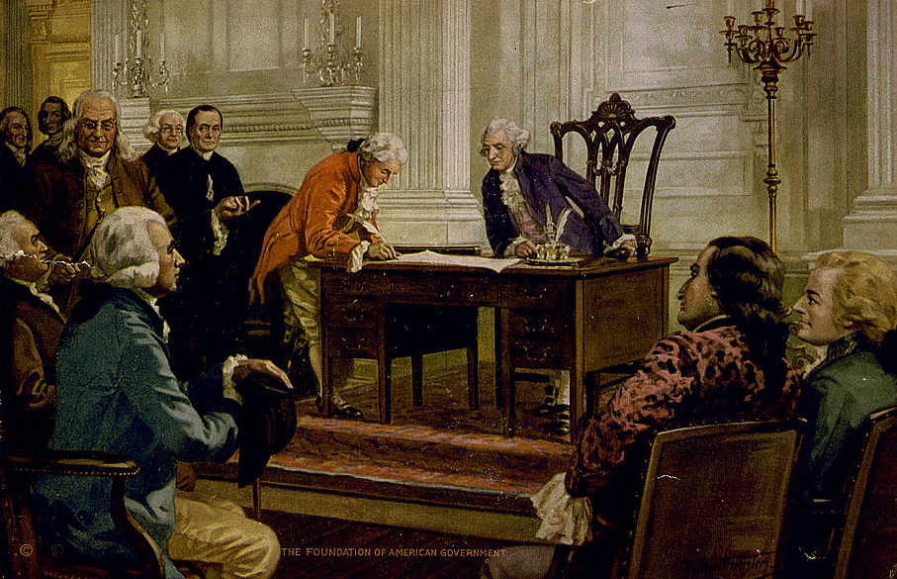
4th Amendment to U.S. Constitution: no “unreasonable” searches & seizures; warrants must be supported by probable cause on oath/affirmation & specifically describe what is to be searched & persons or things to be seized

Slide 18

What Happens When The Law Isn’t Followed?
Evidence may not be admissible
Possibly civil & criminal penalties for officer
Rights are violated

Slide 19
Greenwood’s lawyers appealed his conviction.
They argued that the police had no right to search the trash bags.
Therefore the evidence from the trash bags should not have been admitted at the trial.
Notes:
On slide: All text and trash graphic.
Click 1: Access denied sound effect + graphic.
Click to next slide.

Slide 20
Both sides presented oral arguments and briefs to the appeals courts.
Attorneys for the state of California presented this argument:
Police did not conduct a “search” as defined by law. A search is a governmental intrusion into something in which a person has a reasonable expectation of privacy.
Greenwood had thrown away the evidence. He had no reasonable expectation of privacy in trash bags left on the curb for the trash collector.
Therefore the police did not conduct a search.
Notes:
On slide: Both sides…
Attorneys for the state…
Click 1: Police did not…
Click 2: Greenwood had thrown…
Click 3: Therefore the police…
Click to next slide.

Slide 21
Greenwood’s lawyers presented this argument to the appeals court:
Greenwood did have a reasonable expectation of privacy of these bags.
Therefore the police did conduct a search, which they had no right to do.
Notes:
On slide: Greenwood’s lawyers…
Click 1: Greenwood did have…
Click 2: Therefore the police…
Click to next slide.

Slide 22
The case went through the appeals process.
So the state of California appealed the case to the U.S. Supreme Court.
This court also ruled in favor of Greenwood.
Winner
The state then appealed to the California Supreme Court.
This court ruled in favor of Greenwood.
Winner
First, it went to the California Court of Appeals.
Notes:
On slide: The case went through…
Click 1: (from bottom) First, it went to the California Court of Appeals.+ graphic
Click 2: This court ruled in favor of Greenwood. + “winner” graphic.
Click 3: The state then appealed… + graphic.
Click 4: This court also ruled… + “winner” graphic.
Click 5: So the state of California… + graphic.
1. Ask:
What arguments did Greenwood’s attorneys make?
What arguments did the state of California make?
Which side won in the state appellate courts?
Who appealed the case to the U.S. Supreme Court?
Click to next slide.

Slide 23
The U.S. Supreme Court had to decide these questions:
Was it a search?
Did Greenwood have a reasonable expectation that his trash would remain private?
Notes:
On slide: Blue background
Click 1: You are going to take…
Click 2: The U.S. Supreme Court..
Click 3: Was it a search? + Did Greenwood…
Ensure that students understand the questions.
Click to next slide.

Slide 24
The Decision of the U.S. Supreme Court in
California v. Greenwood (1988)
The court found in favor of California.
Writing the opinion of the court, Justice Byron White said:
“. . . plastic garbage bags left . . . at the side of a public street are readily accessible to animals, children, scavengers, snoops, and other members of the public . . . . Moreover, [Greenwood] placed . . . . refuse for the express purpose of [giving] it to . . . the trash collector . . . . [Greenwood] could have no reasonable expectation of privacy in the . . . items . . . discarded.”
Notes:
On slide: The Decision…
Click 1: The court found… + decision.
1. Share the actual Supreme Court decision and dissent (next slide) with the class.

Slide 25
Writing in dissent, Justice William Brennan said:
“Society [should be prepared] to recognize as reasonable an individual’s expectation of privacy in the most private of personal effects sealed in an opaque container and disposed . . . [so as] to commingle it . . . with the trash of others. . . . The mere possibility that unwelcome meddlers might open and rummage through the containers does not negate the expectation of privacy in its contents any more than the possibility of a burglary negates the expectation of privacy in a home . . . .”
How do you think the case should have been decided?
Notes:
On slide: All text.
1. Compare the arguments the students made with the actual decision and dissent.
2. Congratulate the students on their participation.

Slide 26
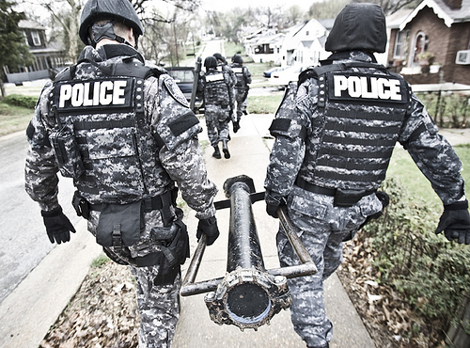
Search Warrant
In some situations investigators do not need a
search warrant to conduct a search.

Slide 27
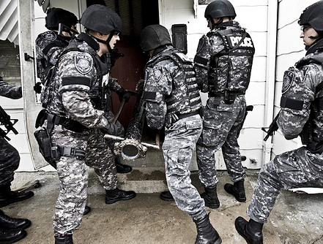
Voluntary Consent - If an individual voluntarily consents (agrees to) a search, no warrant is needed. The key question in this kind of search is what counts as a voluntary agreement? In order for a consent search to be legal, the individual must be in control of the area to be searched and cannot have been pressured or tricked into agreeing to the search. Kayak Trip

Slide 28
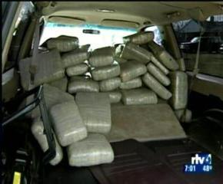
Plain view search - A police officer that spots something in plain view does not need a search warrant to seize the object. In order for a plain view search to be legal, the officer must be in a place he has the right to be in and the object he seizes must be plainly visible in this location.

Slide 29
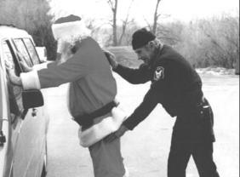
If a suspect has been legally arrested, the police may search the defendant and the area within the defendant's immediate control. In a search incident to arrest no warrant is necessary as long as a spatial relationship exists between the defendant and the object.

Slide 30
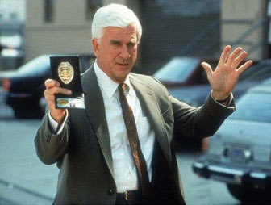
Following an arrest, the police may make a protective sweep search if they reasonably believe that a dangerous accomplice may be hiding in an area near where the defendant was arrested. To do so, police are allowed to walk through a residence and complete a "cursory visual inspection" without a warrant. If evidence of or related to a criminal activity is in plain view during the search, the evidence may be legally seized.

Slide 31
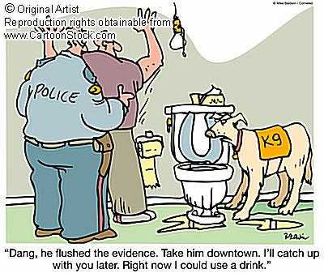

Slide 32
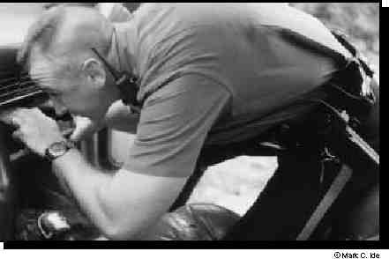
If the police stop a car based on probable cause, they can search for objects related to the reason for the stop without obtaining a warrant. During a car search, the police are also allowed to frisk the subject for weapons, even without a warrant if they have reasonable suspicion that the suspects may be involved in illegal activities

Slide 33
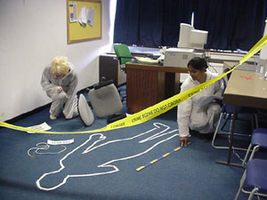
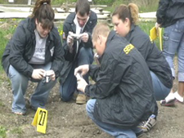

Which should be searched first: outdoor or indoor sites? Why?

Slide 34
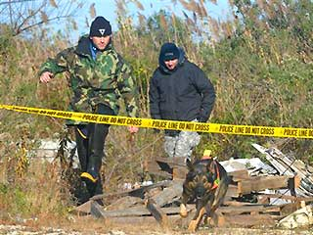
Outdoor zones are always the first to be searched, because the weather is likely to cause damage/alteration to evidence and public areas also hold higher search priority over private areas, as they too, are more difficult to protect.

Slide 35
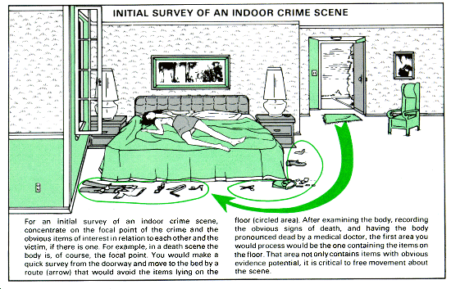
Types of Searches

Slide 36
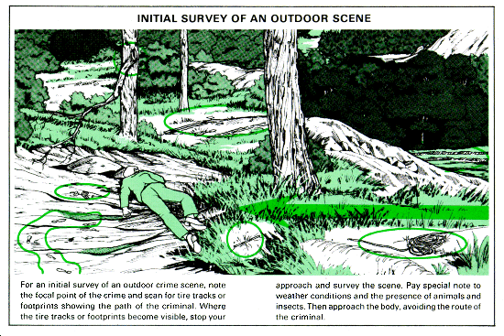

Slide 37
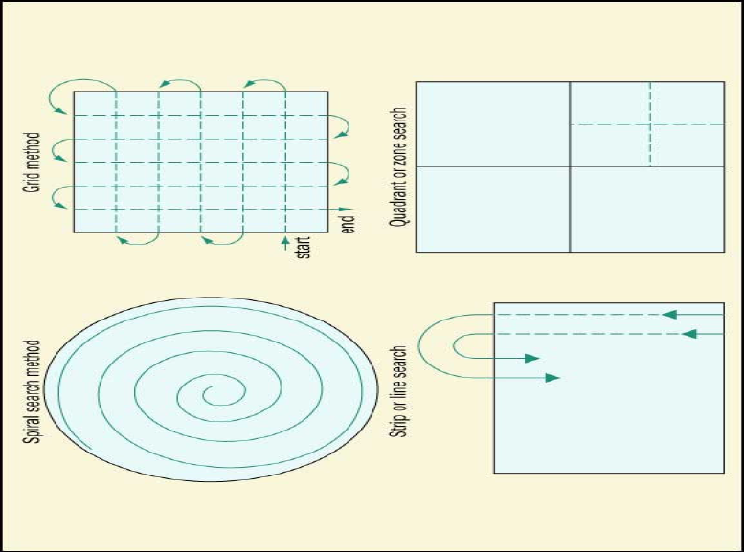

Slide 38
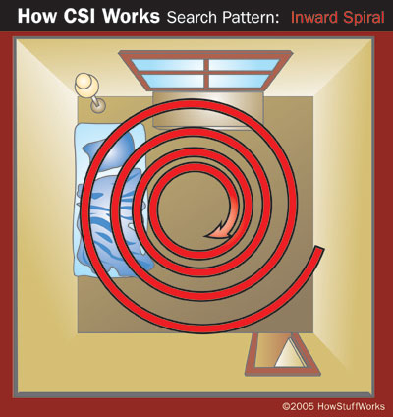
The inward spiral search: The CSI starts at the perimeter of the scene and works toward the center. Spiral patterns are a good method to use when there is only one CSI at the scene.

Slide 39
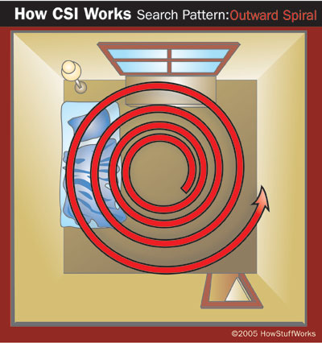
The outward spiral search: The CSI starts at the center of scene (or at the body) and works outward.

Slide 40
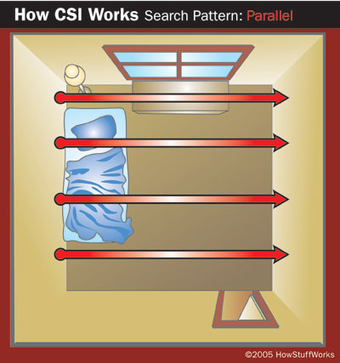
The parallel or line search: All of the members of the CSI team form a line. They walk in a straight line, at the same speed, from one end of crime scene to the other

Slide 41
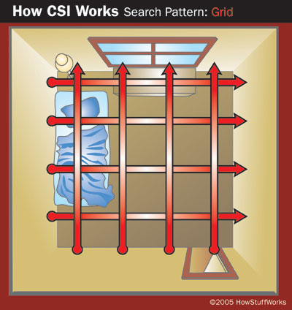
The grid search: A grid search is simply two parallel searches, offset by 90 degrees, performed one after the other

Slide 42
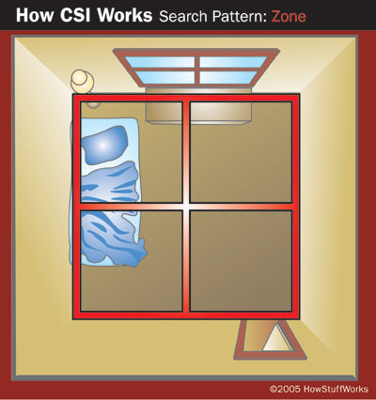
The zone or quadrant search: In a zone search, the CSI in charge divides the crime scene into sectors, and each team member takes one sector. Team members may then switch sectors and search again to ensure complete coverage.

